Slide 1
Guide to Programming with Python
Chapter Six
Functions: The Tic-Tac-Toe Game

Slide 2
Objectives
Write your own functions
Accept values into your functions through parameters
Return information from your functions through return values
Work with global variables and constants
Create a computer opponent that plays a strategy game
Guide to Programming with Python

Slide 3
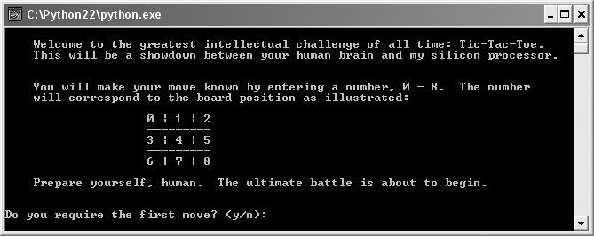
The Tic-Tac-Toe Game
Figure 6.1: Instructions screen of the Tic-Tac-Toe game
The computer is full of... confidence.
Guide to Programming with Python

Slide 4
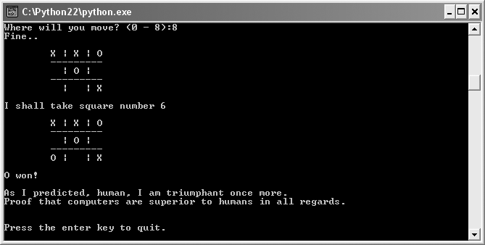
The Tic-Tac-Toe Game (continued)
Figure 6.2: The computer wins the Tic-Tac-Toe game.
With just simple programming, the computer plays a decent game.
Guide to Programming with Python

Slide 5
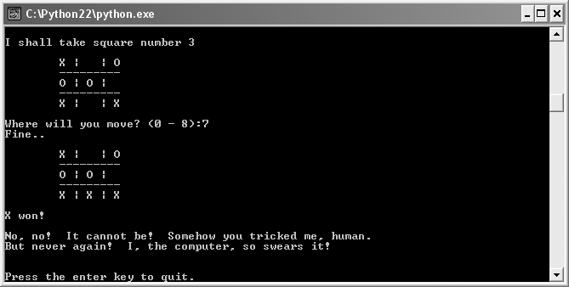
The Tic-Tac-Toe Game (continued)
Figure 6.3: The computer loses the Tic-Tac-Toe game.
The computer’s simple programming allows it to be beat.
Guide to Programming with Python

Slide 6
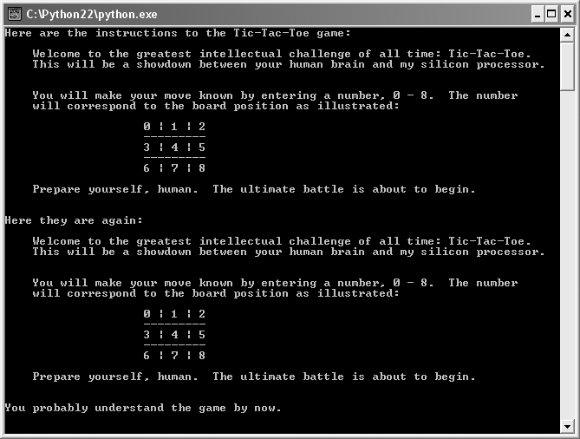
The Instructions Program
Figure 6.4: Sample run of the Instructions program
Instructions are displayed each time with a single call to a function.
Guide to Programming with Python

Slide 7
Creating Functions
Can define functions of your own
Functions let you to break up code into manageable chunks
Programs that are a long series of instructions are hard to write, understand, and maintain
Just like built-in functions, your new functions should do one job well
Guide to Programming with Python

Slide 8
Defining a Function
def instructions():
"""Display game instructions."""
print "Welcome to the world's greatest game!"
Functions make programs easier to read, write and maintain
Function definition: Code that defines what a new function does
Function header: First line of a function definition
Give function name that conveys what it does or produces
Guide to Programming with Python

Slide 9
Documenting a Function
def instructions():
"""Display game instructions."""
print "Welcome to the world's greatest game!"
Docstring: String that documents a function
Docstrings
  Triple-quoted strings
  Must be the first line in your function
  Not required, but a good idea
  Pop up as interactive documentation in IDLE
Guide to Programming with Python

Slide 10
Calling a Programmer-Created Function
instructions()
Call tells the computer to execute function instructions()
Call works just like call to built-in function
Tells the computer to execute previously-defined function
Guide to Programming with Python

Slide 11
Abstraction
Abstraction: Mechanism that lets you think about the big picture without worrying about the details
Functions facilitate abstraction
Can call function instructions() without worrying about the details
Guide to Programming with Python

Slide 12
Using Parameters and Return Values
Just as with built-in functions
  Your functions can get values
  Your functions can return values
Guide to Programming with Python

Slide 13
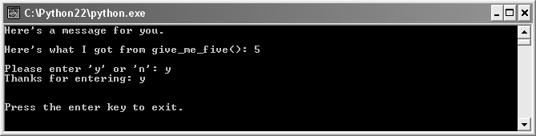
The Receive and Return Program
Figure 6.5: Sample run of the Receive and Return program
Functions use a parameter, a return value, or both.
Guide to Programming with Python

Slide 14
Receiving Information through Parameters
def display(message):
print message
Parameter: A variable name inside the parentheses of a function header that can receive a value
Argument: A value passed to a parameter
Parameters must get values; otherwise, error
Multiple parameters can be listed, separated by commas
Sample call: display("Here’s a message for you.")
Guide to Programming with Python

Slide 15
Returning Information through Return Values
def give_me_five():
five = 5
return five
Return value: A value returned by a function
return statement returns values from a function
return statement ends function call
Can return more than one value from a function -- list all the values in return statement, separated by commas
Sample call: number = give_me_five()
Guide to Programming with Python

Slide 16
Encapsulation
Encapsulation: A technique of keeping independent code separate by hiding the details
Variables created in a function cannot be directly accessed outside the function
Parameters created in a function cannot be directly accessed outside the function
Parameters and return values allow for information exchange
Guide to Programming with Python

Slide 17
Receiving and Returning Values in the Same Function
def ask_yes_no(question):
"""Ask a yes or no question."""
response = None
while response not in ("y", "n"):
response = raw_input(question).lower()
return response
Receives one value and returns another
Receives a value through its parameter question
Returns a value (either "y" or "n") through response
Sample call: answer = ask_yes_no(“Enter y or n: ")
Guide to Programming with Python

Slide 18
Software Reuse
Software reuse: Leveraging existing software in a new project
Software Reuse can:
  Increase productivity
  Improve software quality
  Provide consistency across products
  Improve software performance
Guide to Programming with Python

Slide 19
Using Keyword Arguments and Default Parameter Values
Can pass values to specific parameters
Can give parameters default values
Guide to Programming with Python

Slide 20
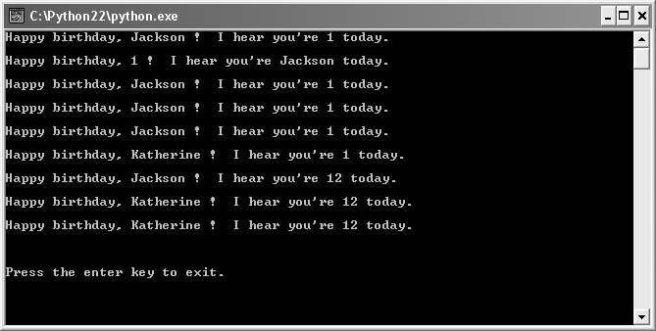
The Birthday Wishes Program
Figure 6.6: Sample run of the Birthday Wishes program
Keyword arguments and default parameter values add flexibility.
Guide to Programming with Python

Slide 21
Positional Parameters and Positional Arguments
def birthday1(name, age):
print "Happy birthday,", name, "!", "You’re", age, ". "
Positional parameters: A list of names in a function header
name and age are positional parameters
Guide to Programming with Python

Slide 22
Positional Parameters and Positional Arguments (continued)
>>> birthday1("Jackson", 1)
Happy birthday, Jackson! You're 1.
>>> birthday1(1, "Jackson")
Happy birthday, 1! You're Jackson.
Positional arguments: A list of argument values in a function call
With positional parameters and positional arguments, parameters get their values based on the order of the values sent
Guide to Programming with Python

Slide 23
Positional Parameters and Keyword Arguments
>>> birthday1(name = "Jackson", age = 1)
Happy birthday, Jackson! You're 1.
>>> birthday1(age = 1, name = "Jackson")
Happy birthday, Jackson! You're 1.
Keyword argument: Argument passed to a specific parameter using the parameter name
Guide to Programming with Python

Slide 24
Default Parameter Values
def birthday2(name = "Jackson", age = 1):
print "Happy birthday,", name, "!", "You’re", age, ". "
Default parameter value: A value that a parameter gets if no value is passed to it
Guide to Programming with Python

Slide 25
Default Parameter Values (continued)
>>> birthday2()
Happy birthday, Jackson! You're 1.
>>> birthday2(name = "Katherine")
Happy birthday, Katherine! You're 1.
>>> birthday2(age = 12)
Happy birthday, Jackson! You're 12.
>>> birthday2(name = "Katherine", age = 12)
Happy birthday, Katherine! You're 12.
>>> birthday2("Katherine", 12)
Happy birthday, Katherine! You're 12.
Guide to Programming with Python

Slide 26
Scopes
Scopes: Different areas of a program that are separate from each other
Every function has its own scope
Functions can't directly access each other's variables
Guide to Programming with Python

Slide 27
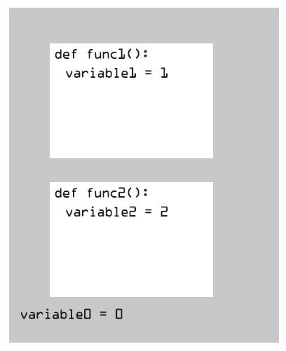
Scopes (continued)
Figure 6.7: Visual representation of program scopes
Three scopes: one for each function, one for the global scope
Guide to Programming with Python

Slide 28
Using Global Variables and Constants
Global variables are variables that can be accessed in any part of a program
Global constants are constants that can be accessed in any part of a program
Guide to Programming with Python

Slide 29
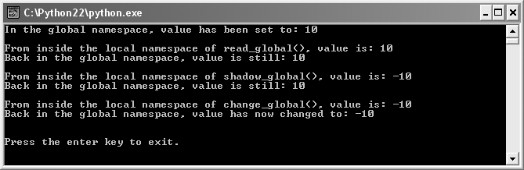
The Global Reach Program
Figure 6.8: Sample run of the Global Reach program
Global variables can be accessed inside any function.
Guide to Programming with Python

Slide 30
Reading a Global Variable from Inside a Function
def read_global():
print "Inside read_global(), value is:", value
value = 10
print "In the global scope, value is:", value, "\n"
read_global()
print "Back in the global scope, value is:", value, "\n"
Guide to Programming with Python

Slide 31
Reading a Global Variable from Inside a Function (continued)
Global variable: A variable created in the global scope that can be accessed in any part of a program
Local variable: A variable created in a scope other than the global scope that can't be accessed outside of its scope
Can read the value of a global variable from within any scope in your program
Guide to Programming with Python

Slide 32
Shadowing a Global Variable from Inside a Function
def shadow_global():
value = -10
print "Inside shadow_global(), value is:", value
value = 10
shadow_global()
print "Back in global scope, value is still:", value
Shadow: To hide a global variable inside a scope by creating a new local variable of the same name
Not a good idea to shadow a global variable
Guide to Programming with Python

Slide 33
Changing a Global Variable from Inside a Function
def change_global():
global value
value = -10
print "Inside change_global(), value is:", value
value = 10
change_global()
print "Back in the global scope, value is now:", value
Can gain direct access to global variable with keyword global
Guide to Programming with Python

Slide 34
Understanding When to Use Global Variables and Constants
Use of global variables can lead to confusion
Limit use of global variables
Global constant: Global variable treated as a constant
Use of global constants can make programs clearer
Guide to Programming with Python

Slide 35
Planning the Tic-Tac-Toe Game
Pseudocode
Representing the data
List of functions
Guide to Programming with Python

Slide 36
Tic-Tac-Toe Pseudocode
display the game instructions
determine who goes first
create an empty tic-tac-toe board
display the board
while nobody’s won and it’s not a tie
if it’s the human’s turn
get the human’s move
update the board with the move
otherwise
calculate the computer’s move
update the board with the move
display the board
switch turns
congratulate the winner or declare a tie
Guide to Programming with Python

Slide 37
Representing the Tic-Tac-Toe Data
Use a single list of 9 elements to represent the board
List elements will be strings, one character long
  Empty will be " "
  X will be "X"
  O will be "O"
Guide to Programming with Python

Slide 38
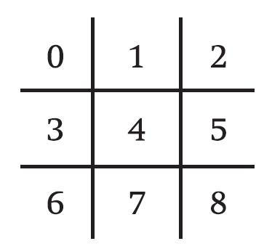
Representing the Tic-Tac-Toe Data (continued)
Figure 6.9: Visual representation of the game board
Each square number corresponds to a position in the list.
Guide to Programming with Python

Slide 39
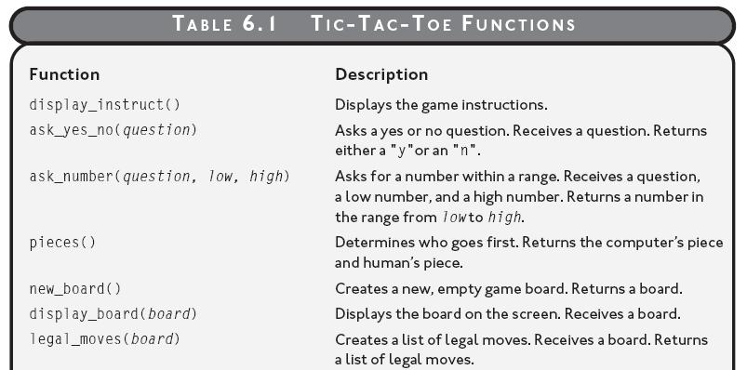
Tic-Tac-Toe Functions
Table 6.1: Tic-Tac-Toe Functions
Planned functions for the Tic-Tac-Toe game
Guide to Programming with Python

Slide 40
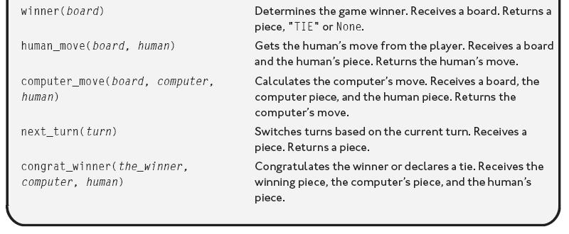
Tic-Tac-Toe Functions (continued)
Table 6.1 (continued): Tic-Tac-Toe Functions
Planned functions for the Tic-Tac-Toe game
Guide to Programming with Python

Slide 41
Summary
A function definition begins with the keyword def
A docstring is a string that immediately follows a function header and that documents the function
Abstraction is a mechanism that lets you think about the big picture without worrying about the details
A parameter is a name in a function header that can receive a value
An argument is a value in a function call that’s passed to a parameter
Guide to Programming with Python

Slide 42
Summary (continued)
A return value is a value returned by a function
Encapsulation is a technique of keeping independent code separate by hiding the details
Variables and parameters created in a function cannot be directly accessed outside the function
Software reuse is leveraging existing software in a new project
A keyword argument is an argument passed to a specific parameter using its parameter name
Guide to Programming with Python

Slide 43
Summary (continued)
A default parameter value is a value that a parameter gets if no value is passed to it
Scopes are different areas of a program that are separate from each other
A global variable is a variable created in the global scope that can be accessed in any part of a program
A local variable is a variable created in a scope other than the global scope that can’t be accessed outside of its scope
You should limit your use of global variables
Guide to Programming with Python

